Slide 1
W207 Final Project:
Stock Prediction Models
John Andrus, Luis Chion, Kevin Fu, Fernando Roriz
Notes:
Hi everyone, in our final project we will be discussing stock price prediction models and some of the challenges faced in such a competitive industry. My name is Fernando Roriz and I will be presenting with John Andrus, Luis Chion and Kevin Fu.

Slide 2
Motivation
Stock price prediction has been a major challenge in finance.
‘Beating the market’ is a long term goal in the field.
Machine learning can be a powerful tool to explore new approaches to the market data.
Which ML models can generate the highest returns in the stock market?
Notes:
Stock price prediction has been a major challenge in finance. As expected, ‘beating the market’ is very hard and machine learning can be a powerful tool in this never ending goal.
But, which models can generate the best results? The main idea in this project is to explore these possibilities and see which Machine Learning models perform better.

Slide 3
Literature
The literature has established that stock market prices do not follow random walks and the variability of stock returns can be explained by factors such as market risk, size and growth (Lo and MacKinlay (RFS, 1988), Fama and French (JF, 1992) and Fama and French (JFE, 1993)).
Cochrane (RFS, 2008) shows that even small out-of-sample R2 (from 4% to 7%) has large economic significance and variables such as dividend-growth ratio are relevant predictors.
Gu, Kelly and Xiu (RFS, 2020) runs a comparative analysis of machine learning methods and shows that best performing methods to measure asset risk premia are trees and neural networks. These models trace their predictive gains to allowance of nonlinear predictor interactions that are missed by other methods.
At this time, many papers are being produced and published trying to apply machine learning techniques to predict stock markets and this project try to add on this strand of the literature.
Notes:
What does the finance literature say about stock market prediction?
Cochrane in 2008 presented a good overview on this topic and showed that even small out-of-sample R-square’s, such as 4% to 7%, have large economic significance, despite their low statistical significance. Therefore, it is important to note that we are not aiming for R-square’s around 80% or 90%. In finance, we are fighting for small gains, but they can mean a lot in economic terms.
Machine learning entered this field and the very recent paper from Gu, Kelly and Xiu shows us that machine learning models such as trees and neural networks can perform better when explaining empirical facts such as asset risk premia.
At this time, many papers are being produced and published trying to apply machine learning techniques to predict stock markets and this project tries to add on this strand of the literature.

Slide 4
Jane Street Market Prediction - Kaggle
In this competition, for a set of possible trades presented, we have to decide if should add this trade to our portfolio or not.
Roughly, our main goal is to add to our portfolio trades that have positive returns and pass the ones with negatives returns.
For each possible trade, we are presented with 130 features and can use them to decide if this will have a positive return or not.
Notes:
How are we going to do this?
We will explore and evaluate the performance of machine learning models through a Kaggle competition. The Jane Street Market Prediction problem gives us a real market dataset and our objective is to decide, given a set of features, if we would add or not a trade to our portfolio.

Slide 5

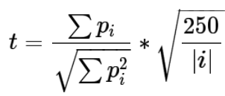

Jane Street Market Prediction - Kaggle
The return of a trade is given by the ‘resp’ variable and ‘weight’ represents the leverage for that specific trade. Finally, the ‘action’ variable is our binary target that takes value 1 if resp > 0, and 0 otherwise.
The competition is evaluated on the following utility score:
,where
|i| is the number of unique dates in the test set.
Notes:
For each trade, the dataset gives us its return, represented by the resp variable, as we can see in the first formula, and also the weight of the trade, which represents the leverage we are going to take. The action variable is our target variable and it takes value 1 if the resp variable is greater than zero, and 0 otherwise. This means that we are trying to get the trades that have positive returns.
The competition is evaluated using the utility score presented in the bottom which roughly cares about the sum of all trades carried out.
The formulas are a little bit complicated to understand very quickly, but what we have to keep in mind is that we want to get the trades that have positive returns.

Slide 6
Data: Source, Description, Stats
Data
~1.6 million observations of 130 anonymized features
Removed highly corr. features
Raw data 18% null, nulls replaced with median (zeros)
Binary Labels (Target Variable)
1 - Make a Trade
0 - Take No Action
Named Features
Date & ts_id : Integer date and timestamp
Weight and resp : Together represent return on a trade
Notes:
About the data, our dataset has around 1.6 million trades distributed over 500 days and 130 anonymized features. Thus, this is a very agnostic problems. We are trying to predict the market and we do not even know what the features are. But, if it is good for prediction, it should be used, and we do not care about its interpretability.

Slide 7
Model Evaluation
Horse Race across a variety of machine learning techniques:
Random Forest
K-Nearest Neighbors
Naive Bayes
OLS
OLS with PCA
Logistic Regression with PCA
Ridge Regression
LASSO
Elastic Net
LSTM
GMM
CNN
Notes:
Finally, how are we going to evaluate our results?
We will conduct a horserace across a variety of machine learning techniques to identify the valuable trades. In the end, we will have the accuracy and the correspondent utility score for the models showed above..
With this overview of the project, I will now turn the floor over to John.

Slide 8
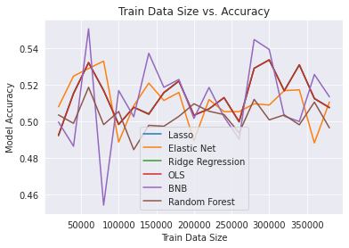
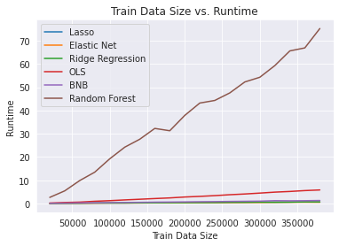
Model Selection: Accuracy vs Runtime
*K-Nearest Neighbors excluded due to extremely long runtimes
Notes:
As we mentioned prior, our dataset consists of many examples of 130 anonymous features
This makes it impossible to use intuition to build models
So we decided to do two things at once. We ran a variety of common models and conducted a literature review
What we found was many of the models varied dramatically in performance and runtime
Graph on the left shows model accuracy for various training data sizes
Graph on the right shows runtime for various training data size

Slide 9
Model Selection
Accurate but Slow
Fast but Inconsistent
Elastic Net
Ridge Reg
GMM
LSTM
CNN
K-Nearest Neighbors
Ordinary Least Squares
Random Forest
Bernoulli Naive Bayes
Multinomial Naive Bayes
Lit Review
Notes:
The bad models were separated out into two categories
Those that performed well quite consistently, but were so computationally intensive that they couldn't scale with our dataset
Those that ran quickly and often achieved good accuracies, but performed very inconsistently
We had some that seemed to be in the sweet spot. Between these and the models supported in our literature review, we still had five models left to choose from, so we made the decision to go with models supported by the literature - those that had succeeded in solving similar problems in the past.

Slide 10
Gaussian Mixture Model (GMM) - Hyperparam Tuning
Performance maximized with 3 GMM Components
Performance best with tied covariance
Improvement potential by implementing PCA
Initial Model
GMM Components = 3
Training Data Size = 50,000
Model Accuracy = 52.83%
Notes:
One model that had been used to solve similar problems in the past was a Gaussian Mixture Model
It's a model that we're all familiar with by now, and I took inspiration from project three to use two competing GMMs as a classifier for our binary trade/hold labels
Initially seemed very promising - achieving almost 53% accuracy on 50k training data for a 3 component model

Slide 11
Evaluating Consistency of Model Performance
Vary Training Data Slice
Full Dataset = 500 Days
Vary Training Data Size
Notes:
But I wanted to dig deeper and figure out if this model was consistent across all the data
Temporal Gridsearch
Varying Training Data

Slide 12
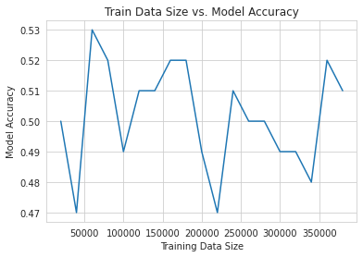
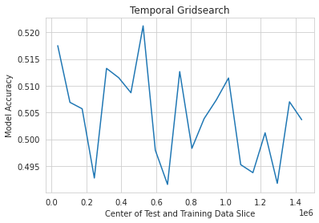
Accuracy Variation by Size and Slice
Notes:
As you can see, it was pretty all over the place
While the accuracy rarely dipped below 50% across all the data slices, it was a far cry from performing consistently at 52.8%

Slide 13
Summary
Preliminary success with 3 Component GMM Models
PCA resulted in reduction of model accuracy below 50%
Inconsistent Performance
Very low utility score
Notes:
In an attempt to improve the model, I implemented PCA, but this actually reduced the accuracy further
We found that while we were able to consistently achieve and accuracy above 50%, we could not consistently outperform other models

Slide 14


Recurrent Neural Networks (RNN) - Long Short Term Memory (LSTM)
Stores information from the past for an arbitrary length of time.
Resistant to noise.
C(t-1)
C(t)
Memory cells replace hidden layers
4 neural network layers: 3 sigmoid, 1 tanh
Cell state “C(t) - conveyor that adds and subtract information
3 gates: forget, input and output
h(t-1)
h(t)

Slide 15
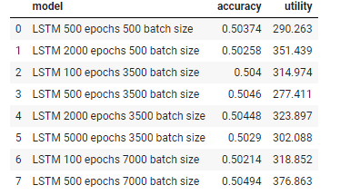
LSTM in depth
Financial Markets
Market prediction as key activity for major financial institutions
Econometric (ARIMA,GARCH) or risk-neutral models are less effective with regime changes
Random nonstationary and noisy sequences
Avoid long-term dependence.
Good non-linearity and self-learning
Model Setting
4 layers each with a dropout layer
Final layer with a sigmoid activation function
epochs = [500, 2000, 5000]
batch_size = 3500 ( 1 week - 500 trades/day )

Slide 16
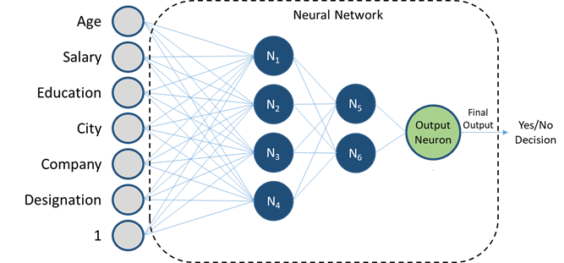
Convolutional Neural Network (CNN) - Overview
Feature 1
Feature 2
Feature 3
1: Action
0: No Action
Feature 4
Feature 5
Feature 6
Feature 7
and on...
Input Layer
Hidden Layers
(Convolutional & Density)
Output Layer
Notes:
Picked CNN b/c: well documented in literature for:
1) its ability to simplify Complex data into binary output,
2) it has more hidden layers vs. a traditional neural network. More Hidden layers = the CNN can extract more features from input data.
In hidden layers: Each node has their own set of filters to apply to each of the features. They determine what weights to assign to each feature.
Each node looks at the features in [Chunks of overlapping blocks] (vs. entire dataset at once).
Goal: ID and Extract the most important features, then use that info to Output 1 or 0.
--------------------------------------------------------------------
-42 sec

Slide 17
Hyperparameter Tuning
Improves Model
Does Not Improve Model
Kernel sizes
Batch sizes
# of epochs
Type of activation function
PCA
# of nodes in density layer
# of nodes in convolutional layers
Training sizes
Notes:
Tried hyperparameter tuning without doing an exhaustive gridsearch.
Tweaking these 5 params (right) did not improve the model, while tweaking these 4 (left) did.
In initial model: Used default params such as kernel size of 1 and no batch sizing.
Lets go to the next slide to see: Which Combination of Parameters was the Most Optimal for the model?
--------------------------------------------------------------------
We can go more in-depth on what each of these params mean, at the end if time permits.
-40 sec
Definitions:
Kernel: Size of the filter matrix in the convolution layer. 1 = 1x1 output in convolutional layer. 10 = 10x10 output.
Batch: # of samples model trains in each iteration. As Luis said, 3500 data points = ~1 week.
Epoch: # of times the model cycles through data.
Sigmoid = Binary classification vs. Softmax = Multi class classification.
Density: # of Nodes in the Output layer. In our case: we have 2 nodes (1 = action, 0 = no action).

Slide 18
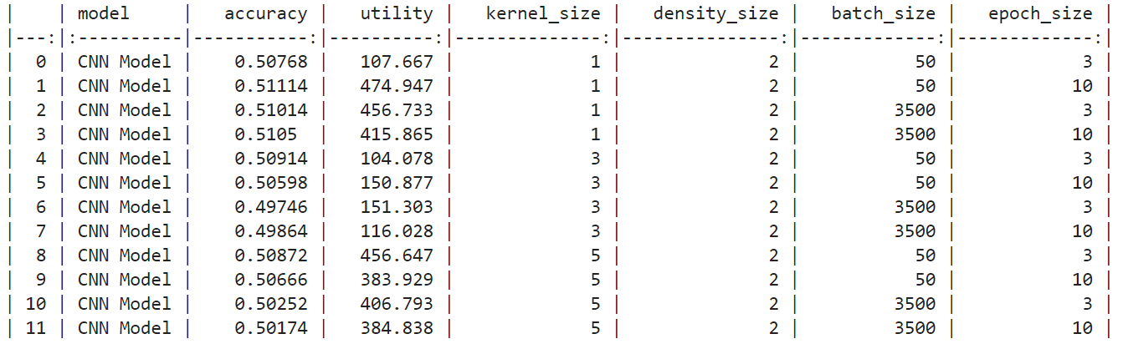
Results
Performance maximized through trial and error
Used variety of different kernel, density, batch, epoch sizes
No one model consistently outperformed
“Best” Model over 12 Iterations
Model Accuracy = 51.1%
Utility Score = 474.95
Kernel Size = 1
Density Size = 2
Batch Size = 50
Epoch Size = 10
Notes:
As you can see on the right - After trying many different combinations of parameters:
Arrived at the best model here on the left.
51% accuracy with ~475 utility.
I say “best” in quotes because this same model was not always the front runner.
No one model consistently outperformed
Depends on parameters - so infinite possibilities
Depends on how we slice & dice the training/test data.
--------------------------------------------------------------------
-36 sec
Kernel: Size of the filter matrix for our convolution. 1 = 1x1 output. 10 = 10x10 output.
Density: # of Nodes in the Output layer. In our case: we have 2 nodes (1 = action, 0 = no action).

Slide 19
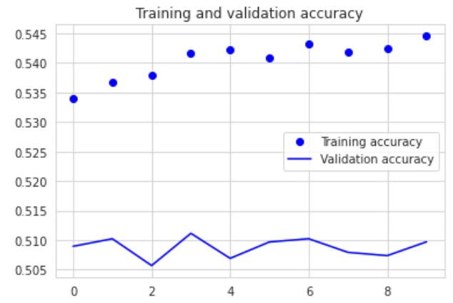
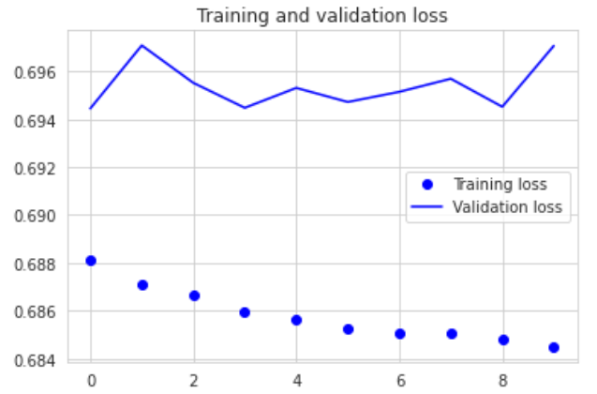
Results: “Best” Model
Accuracy and validation loss are consistent (little variance) over epochs,
Generally does not improve with additional iterations (ceiling @ 3 epochs)
Accuracy
Model Loss
# of epochs
# of epochs
Notes:
In our best model: Accuracy + Validation Loss were fairly consistent over the iterations - that is a plus.
However, we would like to see improvement over each iteration. We do not see that here.
---------------------------------------
-20 sec
Kernel: Size of the filter matrix for our convolution. 1 = 1x1 output. 10 = 10x10 output.
Density: # of Nodes in the Output layer. In our case: we have 2 nodes (1 = action, 0 = no action).

Slide 20
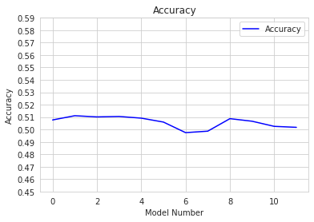
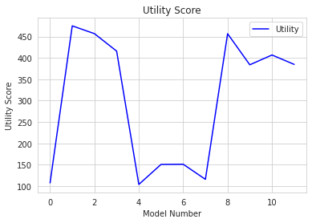
Takeaways
Accuracy and Utility Score in-line with other models
Low variance in accuracy
High variance in utility score
Notes:
The CNN’s accuracy and utility scores were in-line with our other models.
Across the different CNN models we ran, we saw a Low Variance in accuracy (which is good),
but we saw High Variance in the utility score (which is not ideal for stock market prediction).
--------------------------------------------------------------------
-33 sec

Slide 21
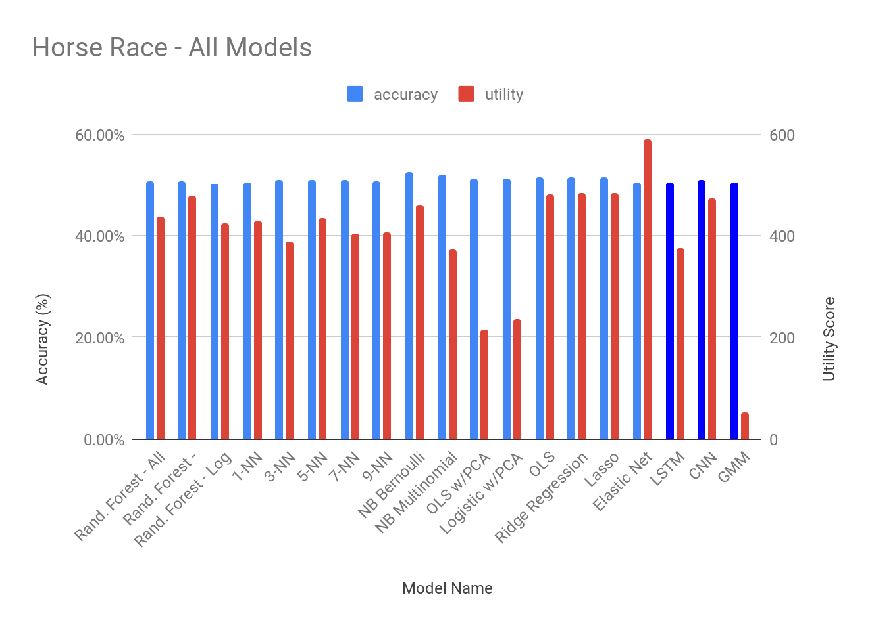
Conclusion
In-line performance with other models
More consistent in terms of accuracy but not utility
Notes:
Here is end result of our horse race for All Models
On the right (dark blue), we have our 3 models that we went the Deepest on, cuz we thought they had most potential for Improvement.
However: They did not sig outperform the rest.
Elastic Net: Highest utility score
Bernoulli Naive Bayes: Highest accuracy
A Silver Lining: The 3 models we focused on were the most Consistent in terms of Accuracy vs. the simpler models (as john prev mentioned)
Its important to reiterate: In stock market prediction, a model with 50-60% accuracy can still be very profitable.
This is Different from other industries such as facial recognition, autonomous driving where you want to achieve 80-90% acc.
Next Steps: Implementing the exhaustive Grid Search | Doing more in-depth analysis on the simpler models
--------------------------------------------------------------------
-1m 7 sec

Slide 22
Appendix

Slide 23
Autoencoder Multi Layer Perceptron (MLP)
Steller, too good to be true numbers
Consistently generates 80%+ accuracy, 3000+ utility
High possibility of overfitting

Slide 24
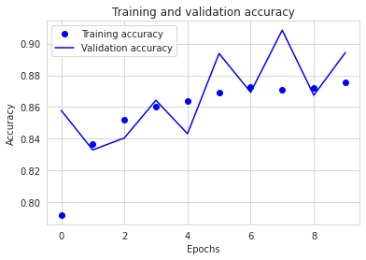
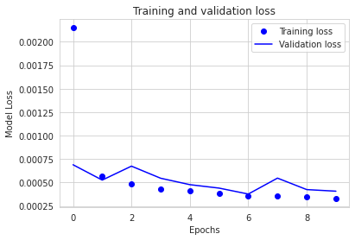
Autoencoder Multi Layer Perceptron (MLP)
Training and Validation Accuracy improves over time
Training and Validation Loss decreases over time (<0.001 validation loss)

